Slide 1
Welcome to Javascript

Slide 2
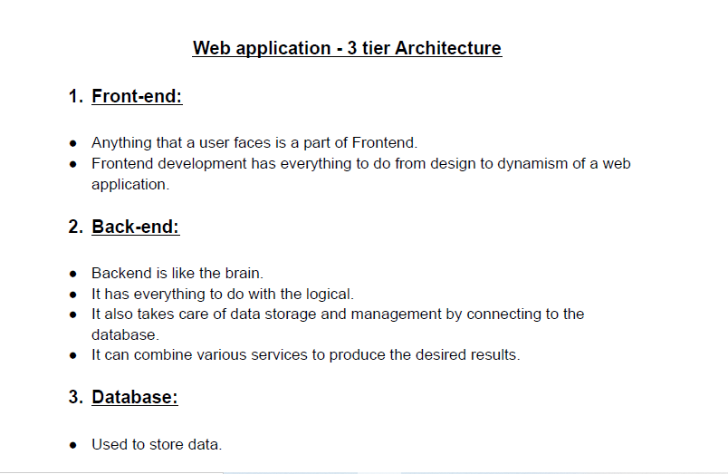
Web Application

Slide 3
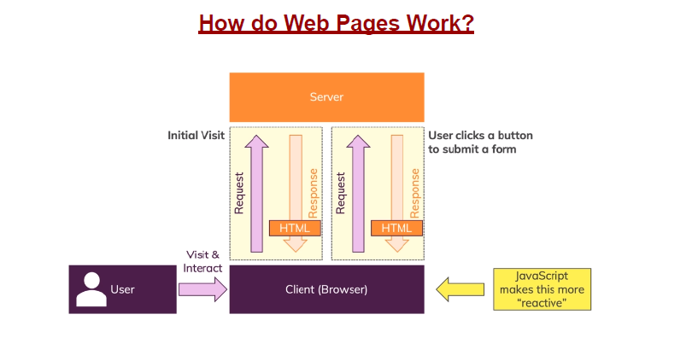
How do Web Pages Work?

Slide 4
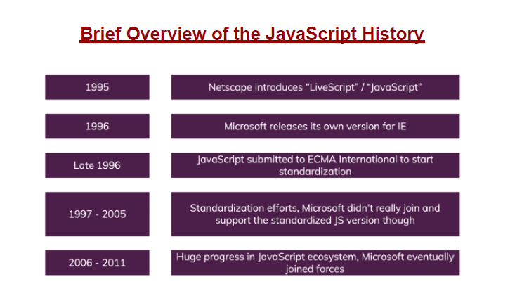
History of Javascript

Slide 5
What is JavaScript?
JavaScript is a client side scripting language (interpreted programming language)
JavaScript make web pages interactive
Open source and cross-platform
Case sensitive
Most commonly used as a part of web pages
JS was created to make web pages more Dynamic (Change content on a page directly from inside the browser)
Supported by all major browsers and enabled by default

Slide 6
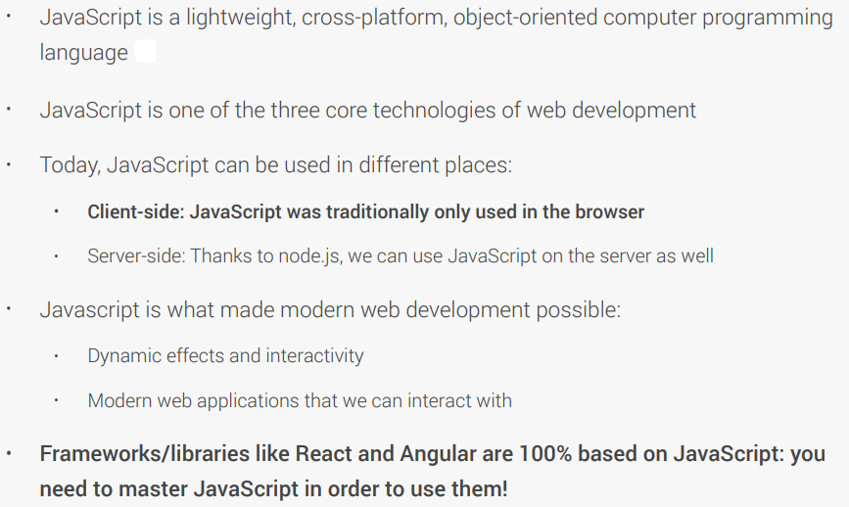
WHAT IS JAVASCRIPT

Slide 7
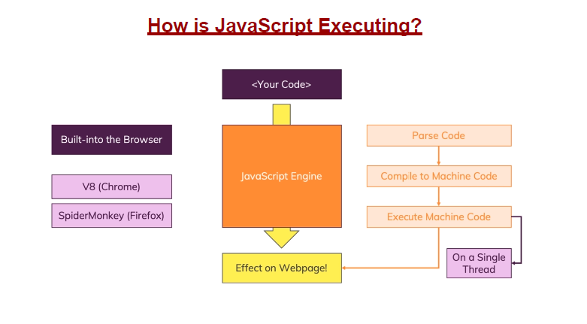
How Javascript Works

Slide 8
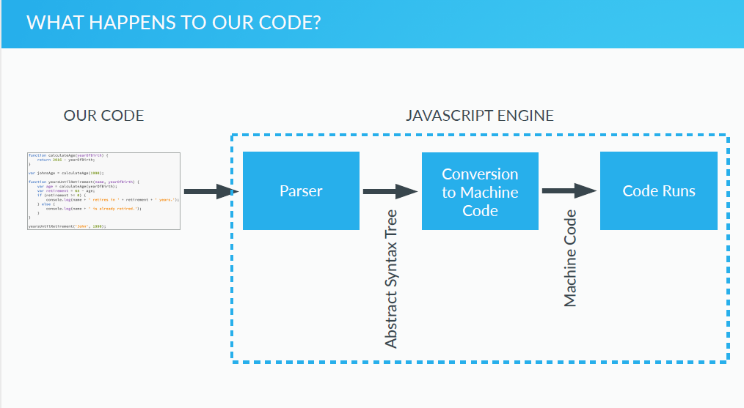
Javascript Engine

Slide 9
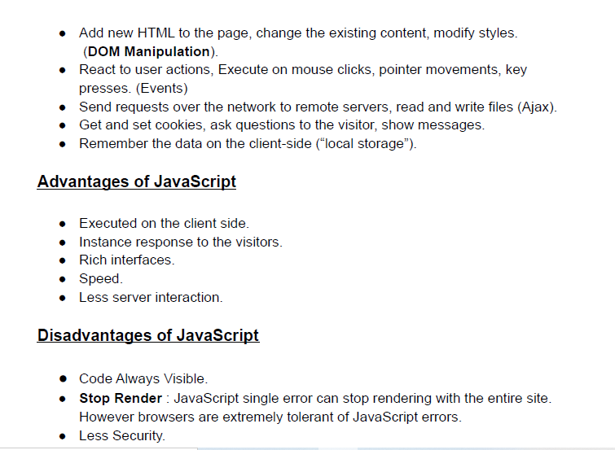
What Javascript Can do?

Slide 10
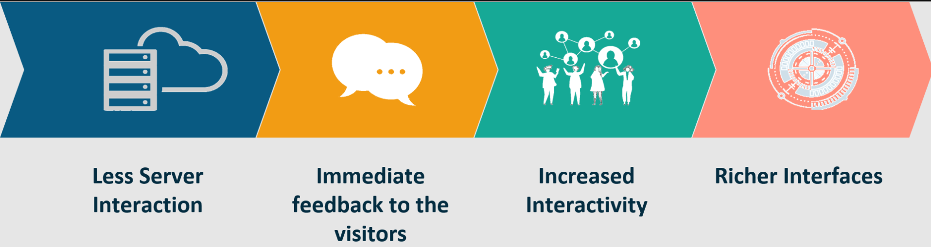
Why JavaScript?
JavaScript adds behavior to web pages
Show or hide more information with the click of a button
Change the color of a button when the mouse hovers over it
Less server interaction
Immediate feedback to the visitors

Slide 11
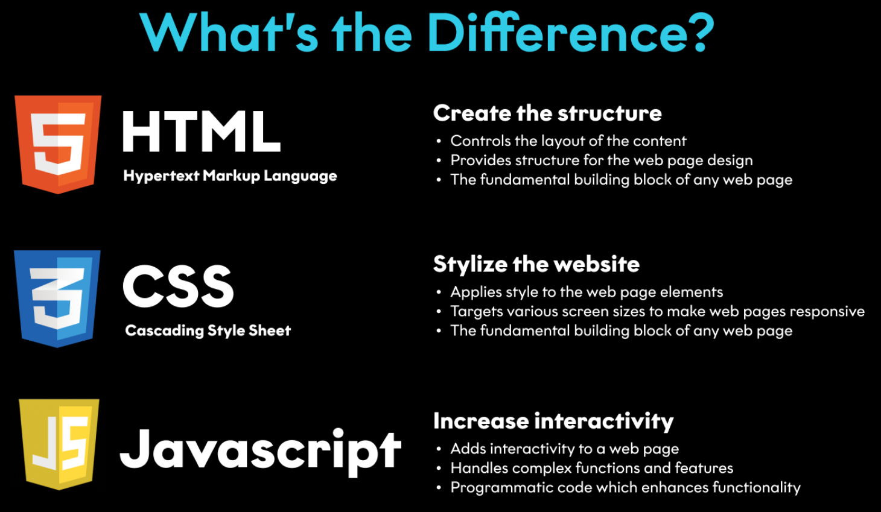
HTML, CSS & JavaScript

Slide 12
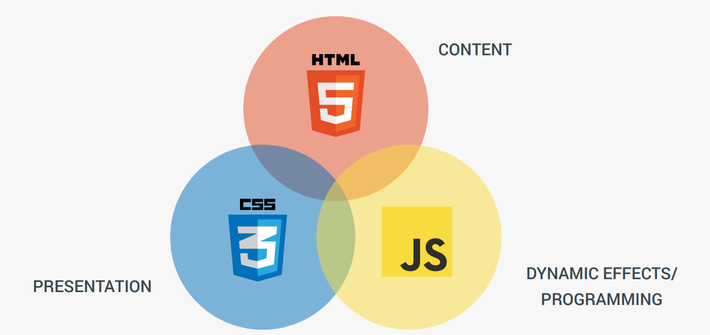
features

Slide 13
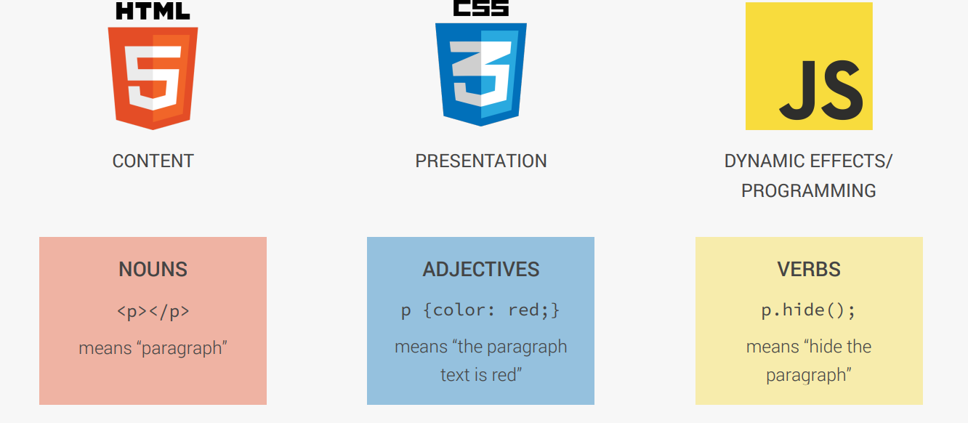
understanding

Slide 14
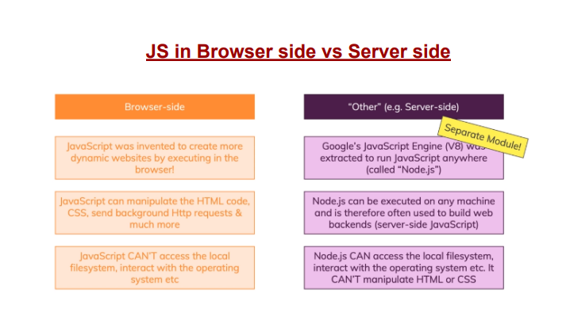

Slide 15
How to Add JavaScript
Internal JS - Internal JavaScript code is code that's placed anywhere within the web page between the HTML tags
External JS
JavaScript code placed in a file separate from the HTML code is called external Javascript.
External JavaScript code is written and used in the same way as internal Javascript.
The file should have the ".js" extension.
<script>
alert("Happy Learning");
</script>
<script src="myScript.js"></script>

Slide 16

Variables in JS
Variables are containers for storing data (values) that hold information and allow us access them later
All JavaScript variables must be identified with unique names
These unique names are called identifiers
We will think of this as a box that has a label on it.
var myNum;

Slide 17
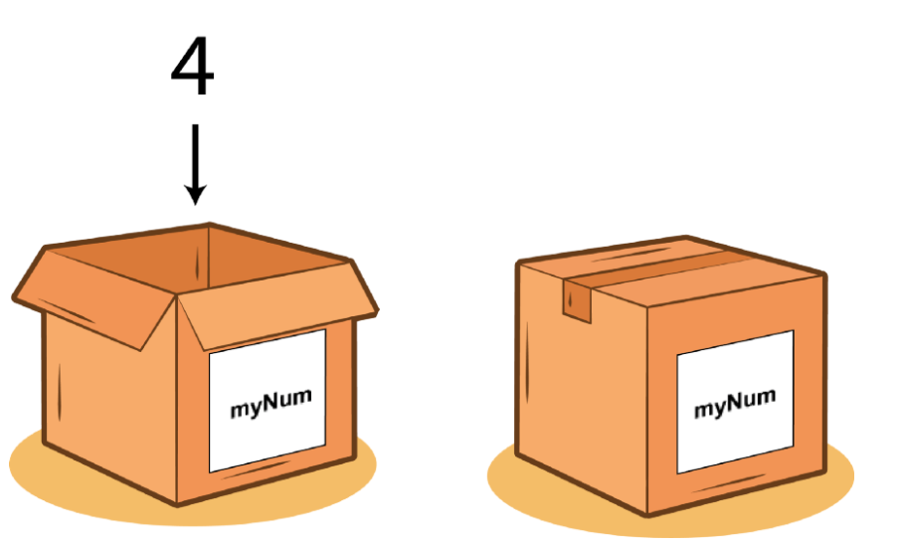
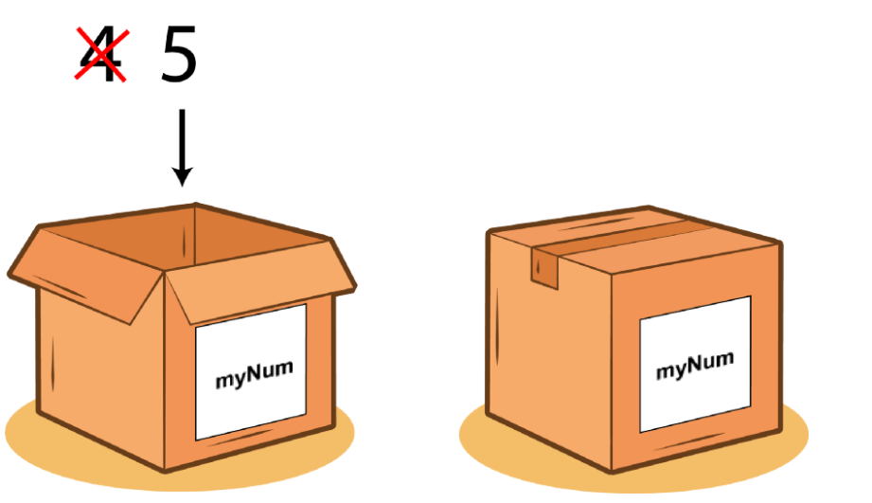
Variables in JS
We can visualise this a box that has a value added to it. Below we add 4 to myNum variable
var myNum = 4;
var myNum = 4
myNum = 5
Changing variables after initialisation (reassignment)

Slide 18
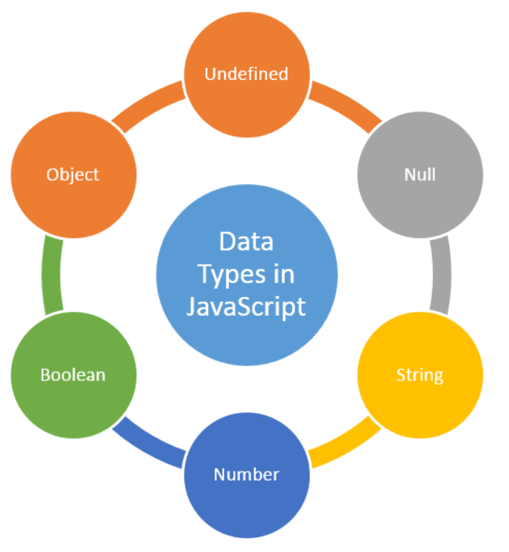
Data Types in JS
A data type specifies the type of data that a variable can store
JavaScript provides different data types to hold different types of values
Two types of data types
Primitive data type
Non-primitive (reference) data type
JavaScript is a dynamic type language,
means you don't need to specify type of the variable
var a= 10; //holding number
var b= "Ram"; //holding string

Slide 19
Primitive Data types
Data Type | Description
String | represents sequence of characters e.g. "hello"
Number | represents numeric values e.g. 100
Boolean | represents boolean value either false or true
Undefined | a data type whose variable is not initialized e.g. let a; you can say that undefined means lack of value or unknown value
Null | represents null i.e. no value at all
var b= "Ram"; //holding string
var a= 10; //holding number
Console.log(Boolean(10 > 9)) // boolean
var myVar = null;

Slide 20
Primitive Data types
null and undefined are primitive values in JavaScript.
A null value means absence.
An undefined value means lack of value.
A null or undefined value evalutes to false in conditional expression.

Slide 21
Non-Primitive Data types
Data Type | Description
Object | represents instance through which we can access members
Array | represents group of similar values
let person = {
firstName: 'John',
lastName: 'Doe'
};
var stringArray = [“John", “Doe"];
var numericArray = [1, 2, 3, 4];

Slide 22
JavaScript Operators
An operator performs some operation on single or multiple operands and produces a result
<Left operand> operator <right operand>
For example, in 1 + 2,
+ sign is an operator and
1 is left side operand and
2 is right side operand
Types of Operators
Arithmetic Operators
Comparison Operators
Logical Operators
Assignment Operators
Conditional Operators
Ternary Operator

Slide 23
JavaScript Operators - Arithmetic
Operator | Description
+ | Adds two numeric operands.
- | Subtract right operand from left operand
* | Multiply two numeric operands.
/ | Divide left operand by right operand.
% | Modulus operator. Returns remainder of two operands.
++ | Increment operator. Increase operand value by one.
-- | Decrement operator. Decrease value by one.
Example: Arithmetic Operation
var x = 5, y = 10;
var z = x + y; //performs addition and returns 15
z = y - x; //performs subtraction and returns 5
z = x * y; //performs multiplication and returns 50
z = y / x; //performs division and returns 2
z = x % 2; //returns division remainder 1
var x = 5;
x++; //post-increment, x will be 5 here and 6 in the next line
++x; //pre-increment, x will be 7 here
x--; //post-decrement, x will be 7 here and 6 in the next line
--x; //pre-decrement, x will be 5 here

Slide 24
JavaScript Operators - Comparison
Operators | Description
== | Compares the equality of two operands without considering type.
=== | Compares equality of two operands with type.
!= | Compares inequality of two operands.
> | Returns a boolean value true if the left-side value is greater than the right-side value; otherwise, returns false.
< | Returns a boolean value true if the left-side value is less than the right-side value; otherwise, returns false.
>= | Returns a boolean value true if the left-side value is greater than or equal to the right-side value; otherwise, returns false.
<= | Returns a boolean value true if the left-side value is less than or equal to the right-side value; otherwise, returns false.
Example: Comparison Operators
var a = 5, b = 10, c = "5";
var x = a;
a == c; // returns true
a === c; // returns false
a == x; // returns true
a != b; // returns true
a > b; // returns false
a < b; // returns true
a >= b; // returns false
a <= b; // returns true

Slide 25
JavaScript Operators - Logical
Operator | Description
&& | && is known as AND operator. It checks whether two operands are non-zero or not (0, false, undefined, null or "" are considered as zero). It returns 1 if they are non-zero; otherwise, returns 0.
|| | || is known as OR operator. It checks whether any one of the two operands is non-zero or not (0, false, undefined, null or "" is considered as zero). It returns 1 if any one of of them is non-zero; otherwise, returns 0.
! | ! is known as NOT operator. It reverses the boolean result of the operand (or condition). !false returns true, and !true returns false.
Example: Logical Operators
var a = 5, b = 10;
(a != b) && (a < b); // returns true
(a > b) || (a == b); // returns false
(a < b) || (a == b); // returns true
!(a < b); // returns false
!(a > b); // returns true

Slide 26
JavaScript Operators - Ternary
JavaScript provides a special operator called ternary operator :? that assigns a value to a variable based on some condition.
Ternary operator ?: is a short form of if-else condition
Syntax:
<condition> ? <value1> : <value2>;
Example:
var a = 10, b = 5;
var c = a > b? a : b; // value of c would be 10
var d = a > b? b : a; // value of d would be 5

Slide 27
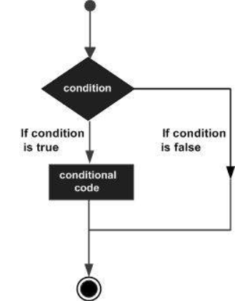
JavaScript conditional statements
JavaScript includes if-else conditional statements to control the program flow, similar to other programming languages.
if condition
if-else condition
else if condition

Slide 28
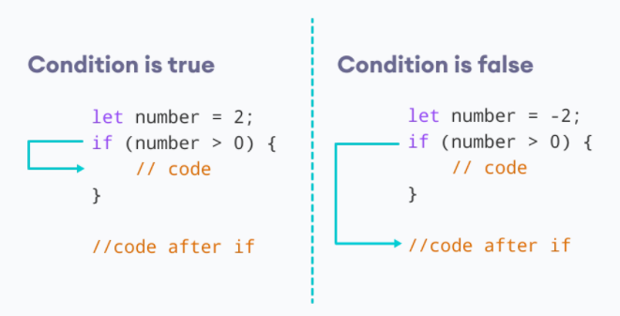
Conditional statements – if condition
The keyword if tells JavaScript to start the conditional statement.
(1 > 0) is the condition to test, which in this case is true — 1 is greater than 0.
The part contained inside curly braces {} is the block of code to run.
Because the condition passes, the variable outcome is assigned the value "if block".
Syntax:
if(condition expression)
{
// code to be executed if condition is true
}
Example:
if( 1 > 0)
{
alert("1 is greater than 0");
}
if( 1 < 0)
{
alert("1 is less than 0");
}

Slide 29
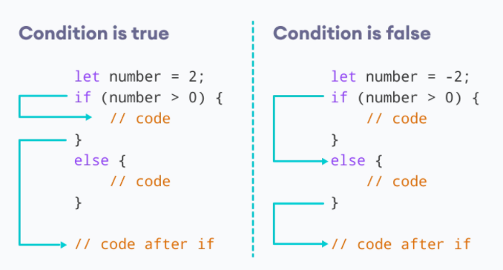
Conditional statements - Else condition
Use else statement when you want to execute the code every time when if condition evaluates to false.
Syntax:
if(condition expression)
{
// block of code to be executed if the condition is true}
else{
// block of code to be executed if the condition is false
}
Example:
let num = 2
// let num = -2
if(number > 0)
{
alert(num +” is greater than 0”);
}
else
{
alert(num +” is less than 0”);
}

Slide 30
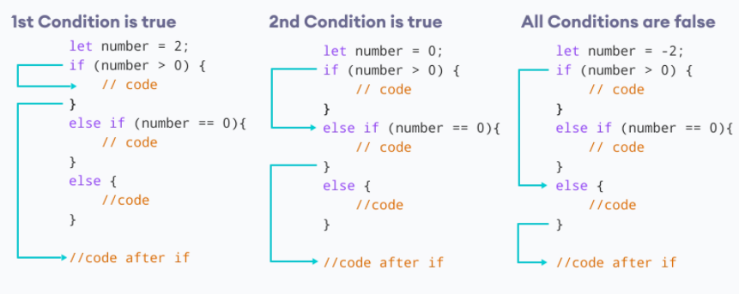
Conditional statements – Else if condition
Use "else if" condition when you want to apply second level condition after if statement
Syntax:
if(condition expression)
{
//Execute this code block
}
else if(condition expression){
//Execute this code block
}
Example:
// check if the number if positive, negative or zero
let number = 2;
number is positive");
} if (number > 0) {
console.log("The
else if (number == 0) {
console.log("The number is 0");
}
else {
console.log("The number is negative");
}

Slide 31
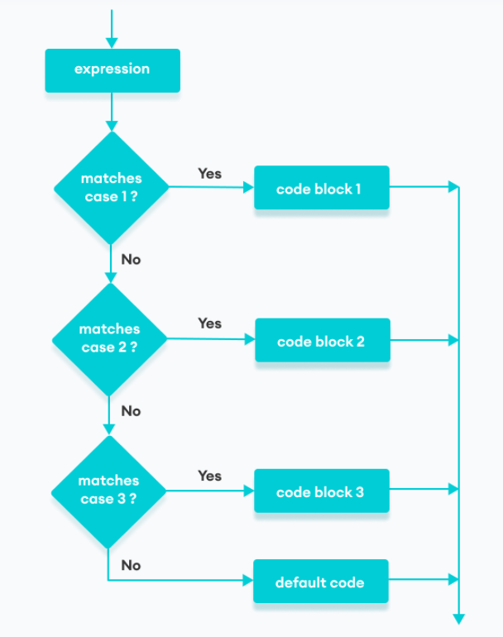
JavaScript conditional statements - Switch
The JavaScript switch statement is used in decision making.
The switch statement evaluates an expression and executes the corresponding body that matches the expression's result.
Syntax:
switch(expression or literal value){
case 1:
//code to be executed
break;
case 2:
//code to be executed
break;
case n:
//code to be executed
break;
default:
//default code to be executed
//if none of the above case executed
}

Slide 32
JavaScript conditional statements - Switch
Example:
let a = 2;
switch (a) {
case 1:
a = 'one';
break;
case 2:
a = 'two';
break;
default:
a = 'not found';
break;
}
console.log(`The value is ‘+{a});
Example:
let str = "bill";
switch (str)
{
case "steve":
alert("This is Steve");
case "bill":
alert("This is Bill");
break;
case "john":
alert("This is John");
break;
default:
alert("Unknown Person");
break;
}

Slide 33
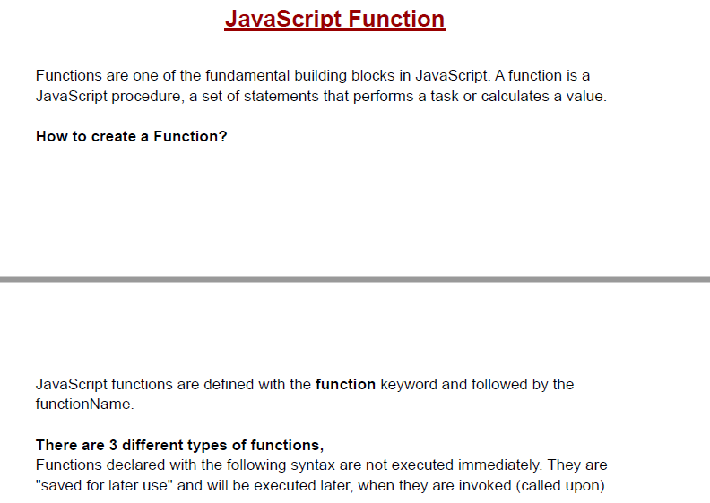
Javascript Function

Slide 34
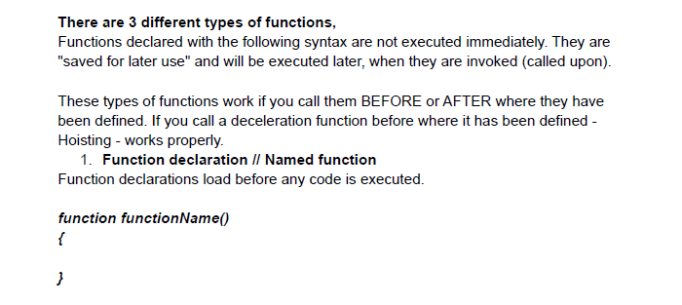
There are 3 different types of functions

Slide 35
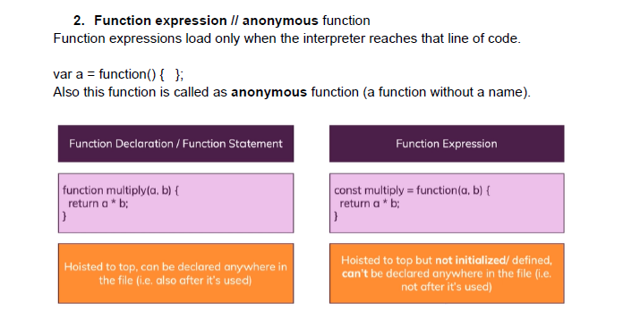
2 Function Expression

Slide 36
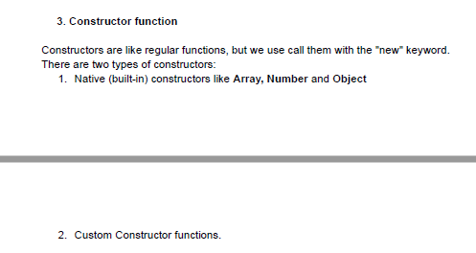
3. Function constructor

Slide 37
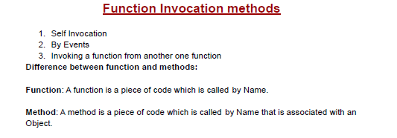
Function invocation methods

Slide 38
Function in JS
Function with parameters:
//defining a function
function ShowMessage(firstName, lastName) {
alert("Hello " + firstName + " " + lastName);
}
//calling a function
ShowMessage(“Ashok", “Kumar");
Function with Return Value:
//defining a function
function Sum(val1, val2) {
return val1 + val2;
};
//calling a function
var result = Sum(10,20); // returns 30

Slide 39
String Methods
length: Returns the number of characters in a string
toUpperCase(): A string is converted to upper case
toLowerCase(): A string is converted to lower case
concat(): joins two or more strings, can be used instead of the plus operator
trim(): method removes whitespace from both sides of a string
charAt(): method returns the character at a specified index (position) in a string
indexOf(): method returns the position of the first occurrence of a specified value in a string, method returns -1 if split(): method divides a String into an ordered list of substrings and returns them as an array

Slide 40
String Methods
Example
let txt = “JavaScript";
let length = txt.length;
let text1 = "Hello World!";
let text2 = text1.toUpperCase();
let text1 = "Hello World!"; // String
let text2 = text1.toLowerCase();
let text1 = "Hello";
let text2 = "World";
let text3 = text1.concat(" ", text2);
let text1 = " Hello World! ";
let text2 = text1.trim();
Example
let text = "HELLO WORLD";
let char = text.charAt(0);
const message = "JavaScript is fun";
// check the first occurrence of 'i' in message
let result = message.indexOf("i");
console.log(result);
str.indexOf(searchValue, fromIndex)
let message = "JavaScript is fun";
let result = message.split(" ");

Slide 41
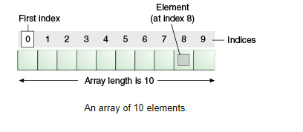
What is array

Slide 42
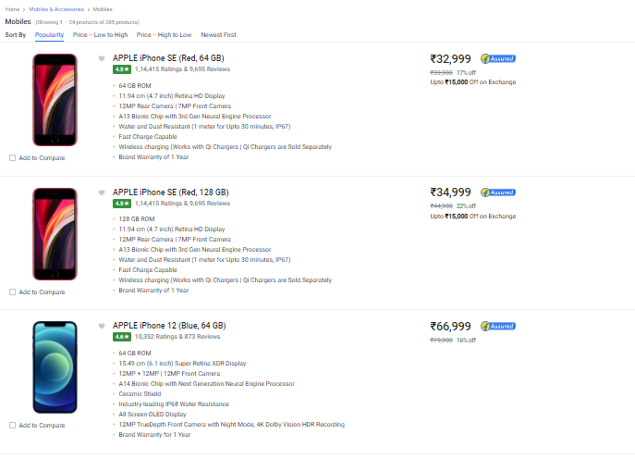
Real world problem- ecommerce

Slide 43
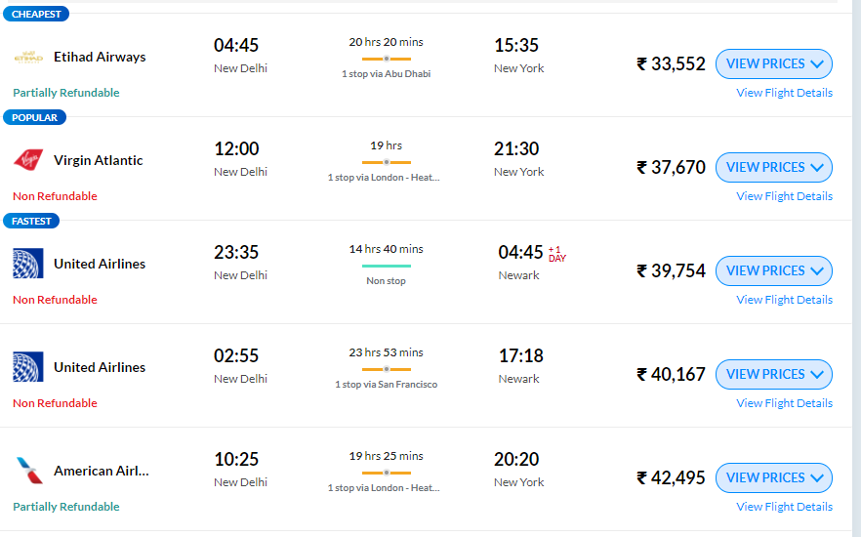
Real world problem - transport

Slide 44
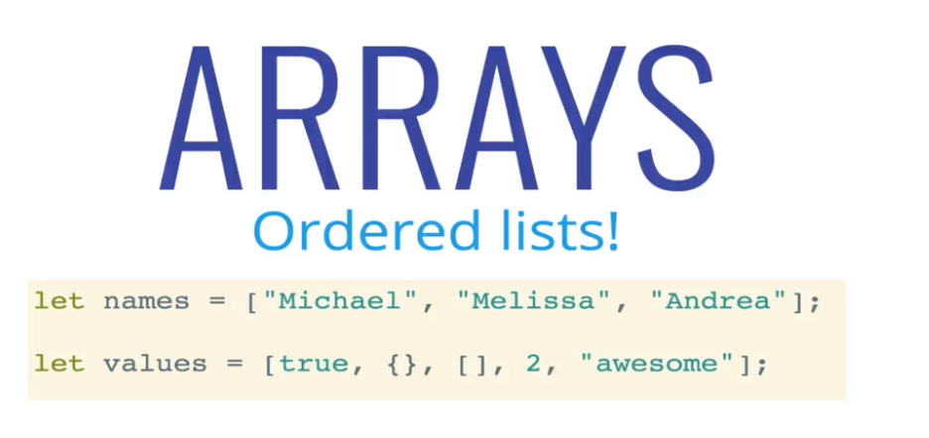
What is array

Slide 45
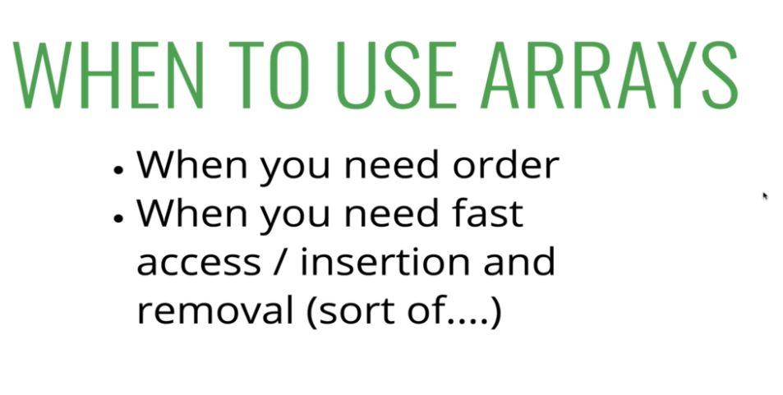
Array?

Slide 46
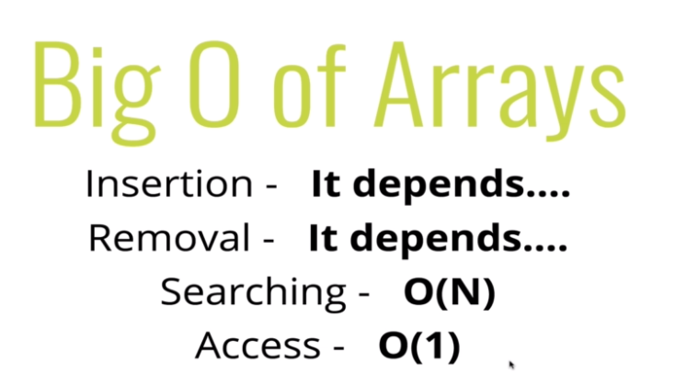
Space and time complexity

Slide 47
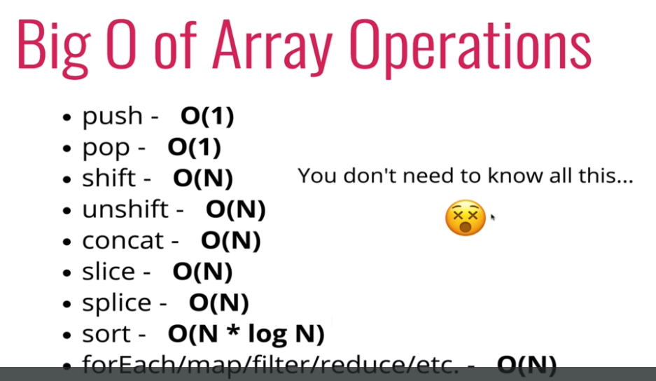
Built in function complexity

Slide 48
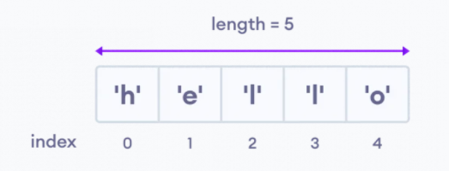
Array
An array is an object that can store multiple values, create an array is by using an array literal []
Create Array:
Access Elements of an Array:
Example:
// empty array
const myList = [ ];
// array of numbers
const numberArray = [ 2, 4, 6, 8];
// array of strings
const stringArray = [ 'eat', 'work', 'sleep'];
// array with mixed data types
const newData = ['work', 'exercise', 1, true];
Example:
const myArray = ['h', 'e', 'l', 'l', 'o'];
// first element
console.log(myArray[0]); // "h“
// second element
console.log(myArray[1]); // "e"

Slide 49
Array Methods
An array is an object that can store multiple values, create an array is by using an array literal []
Arrays to Strings:
const elec = [“Mobile", “Ipad", “Laptop", “Chargers"];
console.log(elec.toString())
join():
const elec = [“Mobile", “Ipad", “Laptop", “Chargers"];
console.log(elec.join("-"))
//mobile-ipad-laptop-charges
Add an Element to an Array:
push() and unshift() to add elements to an array
let dailyActivities = ['eat', 'sleep'];
// add an element at the end
dailyActivities.push('exercise');
console.log(dailyActivities); // ['eat', 'sleep', 'exercise']
let dailyActivities = ['eat', 'sleep'];
//add an element at the start
dailyActivities.unshift('work');
console.log(dailyActivities); // ['work', 'eat', 'sleep']

Slide 50
Array Methods
Change the Elements of an Array:
Add elements or Change the elements by accessing the index value
let dailyActivities = [ 'eat', 'sleep'];
// this will add the new element 'exercise' at the 2 index
dailyActivities[2] = 'exercise';
console.log(dailyActivities); // ['eat', 'sleep', 'exercise']
Remove an Element from an Array:
pop() method to remove the last element from an array. The pop() method also returns the removed element
shift() method removes the first element and also returns the removed element
let dailyActivities = ['work', 'eat', 'sleep', 'exercise'];
// remove the last element
dailyActivities.pop();
console.log(dailyActivities); // ['work', 'eat', 'sleep']
// remove the last element from ['work', 'eat', 'sleep']
const removedElement = dailyActivities.pop();
let dailyActivities = ['work', 'eat', 'sleep'];
// remove the first element
dailyActivities.shift();
console.log(dailyActivities); // ['eat', 'sleep']

Slide 51
Array Methods
Array Length:
Number of elements in an array using the length property
Concat:
The concat() method creates a new array by merging existing array
const dailyActivities = [ 'eat', 'sleep'];
// this gives the total number of elements in an array
console.log(dailyActivities.length); // 2
const myDailyAct = [ 'eat', 'sleep'];
const myAddiction = [“work", “play", “roam"];
const myChildren = myDailyAct.concat(myAddiction);
splice():
The splice() method can be used to add new items to an array
The first parameter (2) defines the position where new elements should be added.
The second parameter (0) defines how many elements should be removed.
The rest of the parameters ("Lemon" , "Kiwi") define the new elements to be added.
const fruits = ["Banana", "Orange", "Apple", "Mango"];
fruits.splice(2, 0, "Lemon", "Kiwi");
const remItems = fruits.splice(2, 2, "Lemon", "Kiwi");
// to remove items
const fruits = ["Banana", "Orange", "Apple", "Mango"];
fruits.splice(0, 1);

Slide 52
Array Methods
slice():
The slice() method slices out a piece of an array into a new array
The slice() method does not remove any elements from the source array.
const fruits = ["Banana", "Orange", "Lemon", "Apple", "Mango"];
const citrus = fruits.slice(2);
//slice() method can take two arguments like slice(1, 3)
const citrus = fruits.slice(1,4);
Sorting an Array:
The sort() method sorts an array alphabetically
Reversing an Array:
The reverse() method reverses the elements in an array
const fruits = ["Banana", "Orange", "Apple", "Mango"];
fruits.sort();
const fruits = ["Banana", "Orange", "Apple", "Mango"];
fruits.reverse();

Slide 53
Array Methods
indexOf():
searches an element of an array and returns its position
//finding the index position of string
const position = dailyActivities.indexOf('work');
console.log(position); // 2
includes():
The includes() method returns true if an array contains a specified value
const fruits = ["Banana", "Orange", "Apple", "Mango"];
fruits.includes("Mango");
isArray():
Check if an object is an array
const fruits = ["Banana", "Orange", "Apple", "Mango"];
let result = Array.isArray(fruits); // true
let text = “testStringArray";
let result = Array.isArray(text); // false

Slide 54
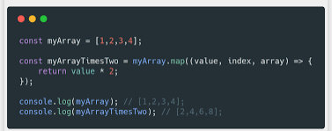
Array Loops – For & Foreach
for:
const fruits = ["Banana", "Orange", "Apple", "Mango"];
for (let i = 0; i < fruits.length; i++) {
console.log(fruits[i]);
}
foreach():
const fruits = ["Banana", "Orange", "Apple", "Mango"];
fruits.forEach(function(item){
console.log(item);
})

Slide 55
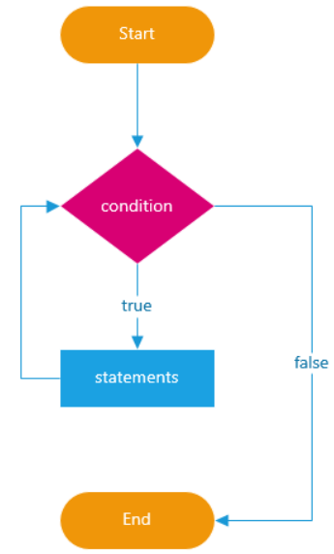
JavaScript Loops
In programming, loops are used to repeat a block of code
For example, if you want to show a message 100 times, then you can use a loop. It's just a simple example; you can achieve much more with loops.
For loop
While loop
do while

Slide 56
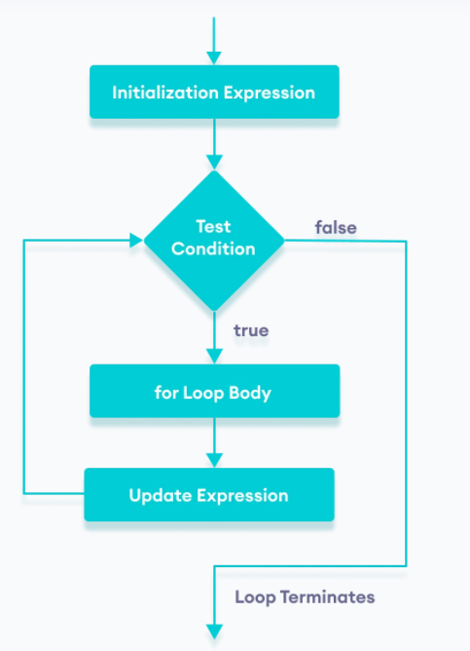
JavaScript Loops - for
The for loop requires following three parts.
Initializer: Initialize a counter variable to start with
Condition: specify a condition that must evaluate to true for next iteration
Iteration: increase or decrease counter
Syntax
for(initializer; condition; iteration)
{
// Code to be executed
}
Example
for (var i = 0; i < 5; i++)
{
console.log(i);
}
let n = 5;
// looping from i = 1 to 5
for (let i = 1; i <= n; i++) {
console.log(`I am learning JavaScript.`);
}

Slide 57
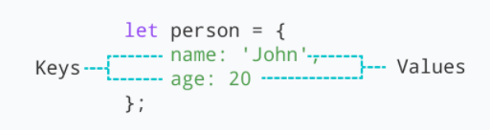
Object
JavaScript object is a non-primitive data-type that allows you to store multiple collections of data
Syntax:
const object_name = {
key1: value1,
key2: value2
}
// object creation
let person = {
name: 'John',
age: 20
};
console.log(typeof person); // object
"key: value" pairs are called properties

Slide 58
Object
Accessing Object Properties:
Syntax:
objectName.key
Or
objectName["propertyName"]
const person = {
name: 'John',
age: 20,
};
// accessing property
console.log(person.name); // John
const person = {
name: 'John',
age: 20,
};
// accessing property
console.log(person["name"]); // John

Slide 59
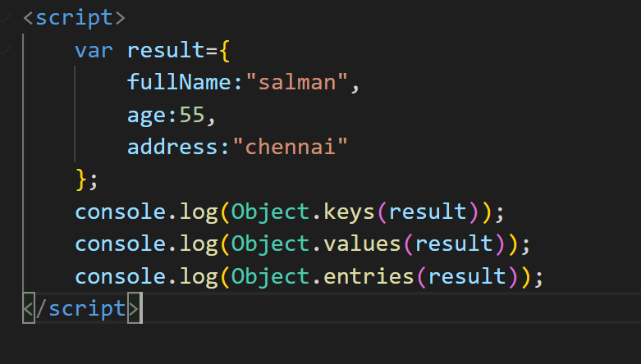
Object – for…in
Loop through an object Using for...in
const student = {
name: 'John',
age: 20,
hobbies: ['reading', 'games', 'coding'],
};
// using for...in
for (let key in student) {
let value;
// get the value
value = student[key];
console.log(key + " - " + value);
}

Slide 60
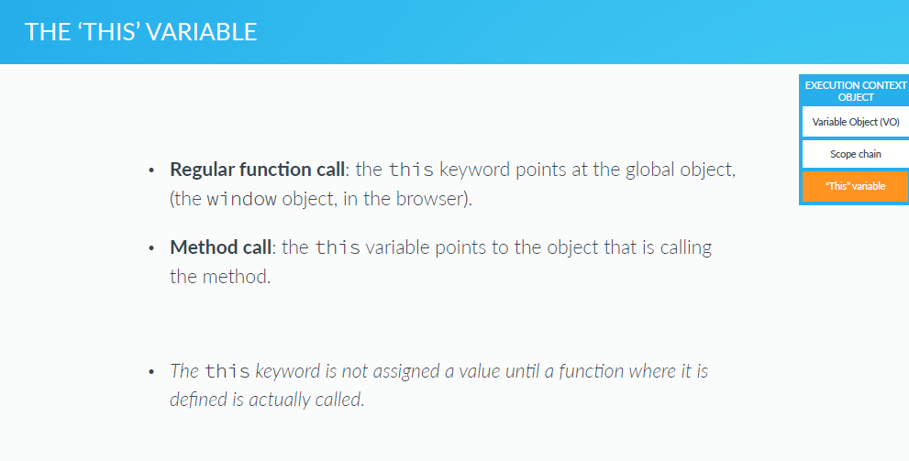
THIS Variable

